Slide 1
Social Hacking Helper (Shh!)
Christopher Jackson (cjackson42@gatech.edu)
Group 3; Slot 5
Final Presentation, November 12, 2023

Slide 2




The Problem
Provide Helpdesk Operators with a fast, easy way to combat Social Engineering scam callers using a simple deployable, scalable, cloud-based tool
98%
5%
Scam?
Bad Actor
Help desk Operator

Slide 3








The Solution
Amazon S3
Scalable Storage
Store recordings
and insights for post analytics
AWS CloudFormation
Infrastructure as code
Ease of deploy mechanism
Automation
98%
5%
Scam?
Good Actor
Help desk Operator
Amazon Connect
Virtual Call Center
Realtime recordings
Amazon Kinesis Video Streams
Real-time Audio Ingestion
Auto-scales
Amazon Transcribe
Speech-to-Text
High-quality transcription
Call Analytics
Pre-trained Machine learning
NLP to detect sentiment,
Interruptions, talk speed, etc.
Amazon Comprehend
NLP capabilities
Conversation insights
Auto detection of
Key phrases, sentiment
Analysis, custom classifier
API, etc.
Amazon CloudFront
Content Delivery Network
Website delivery
Scales globally
Bad Actor

Slide 4
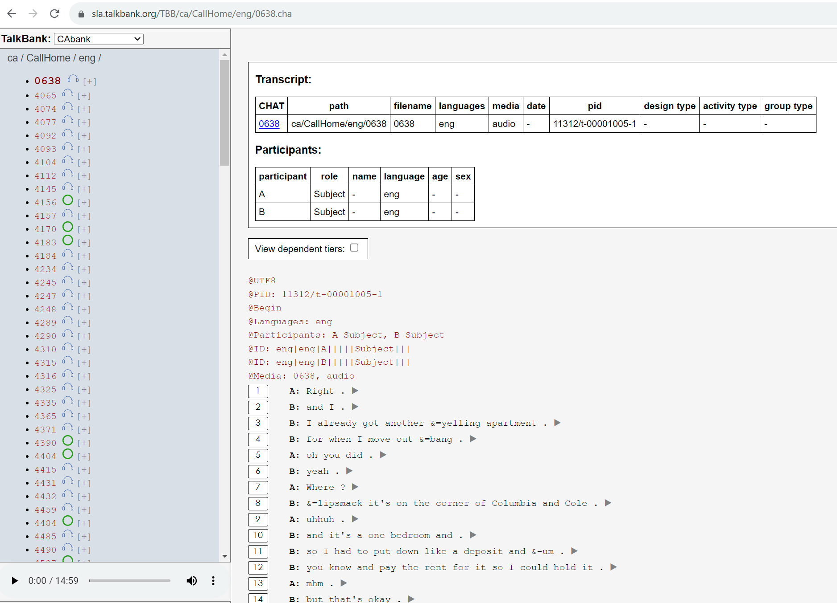
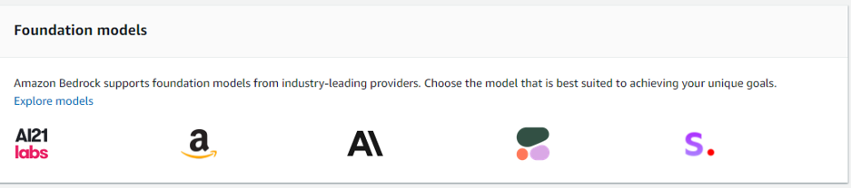
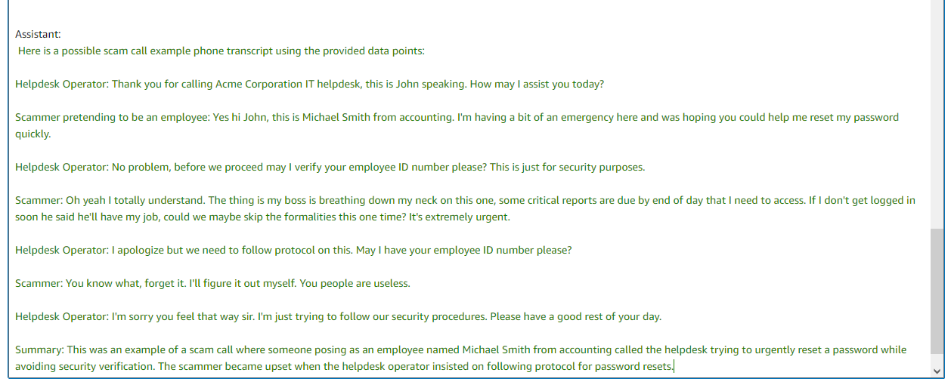
The Datasets
CallHome Database
Generative AI

Slide 5
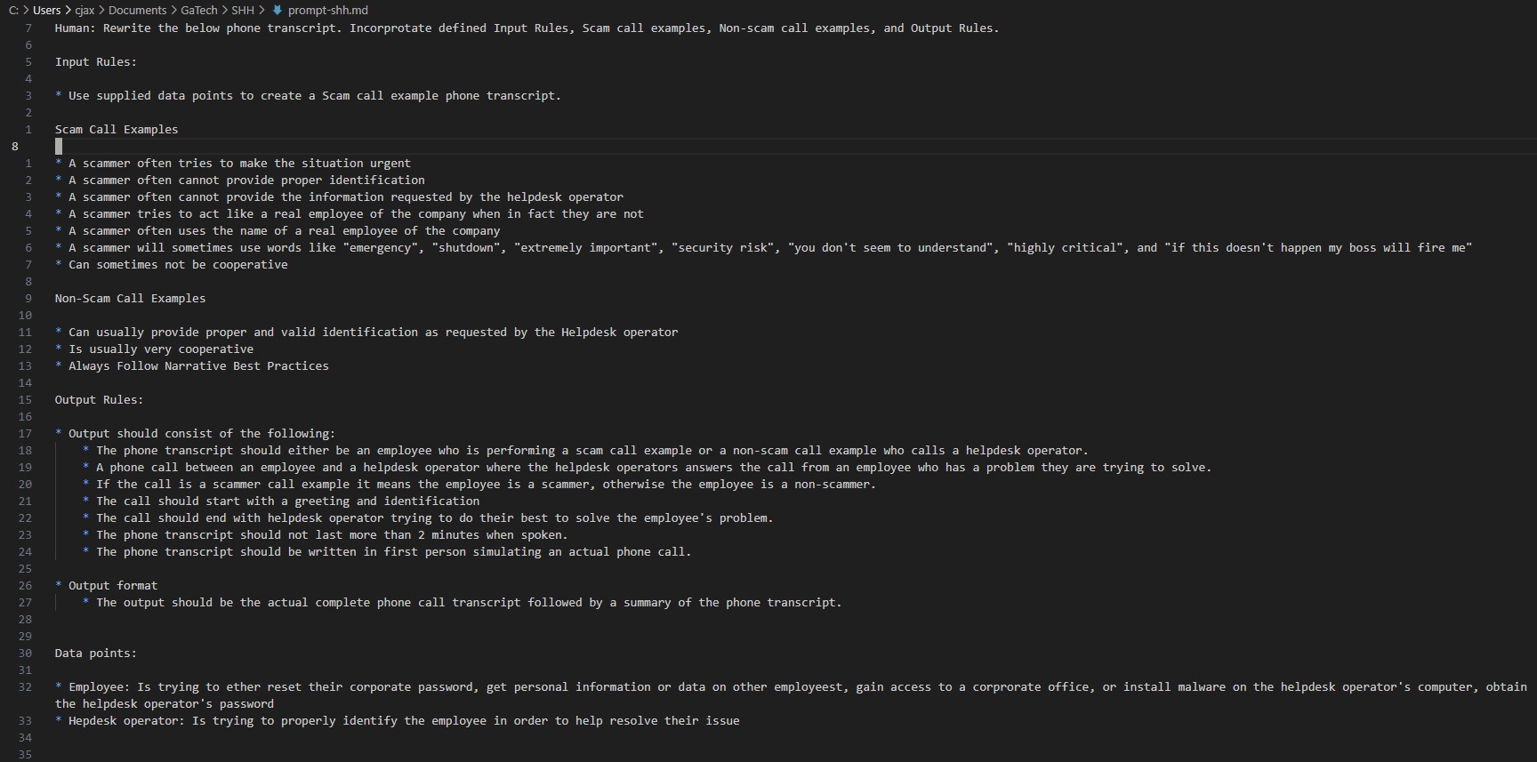
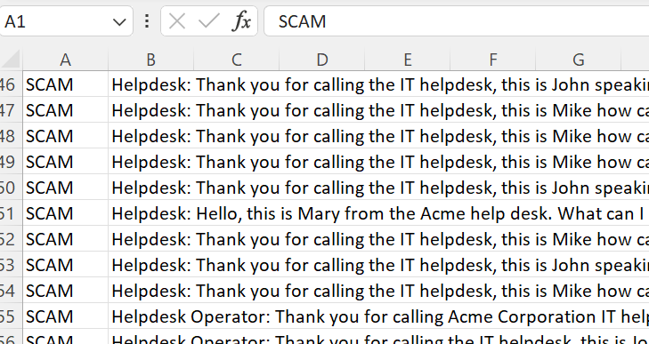
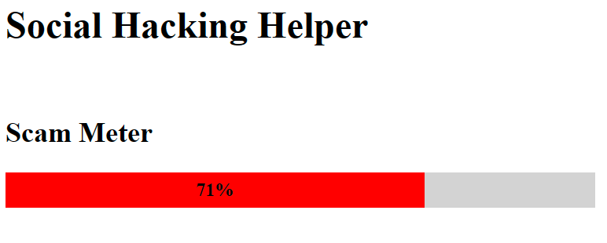
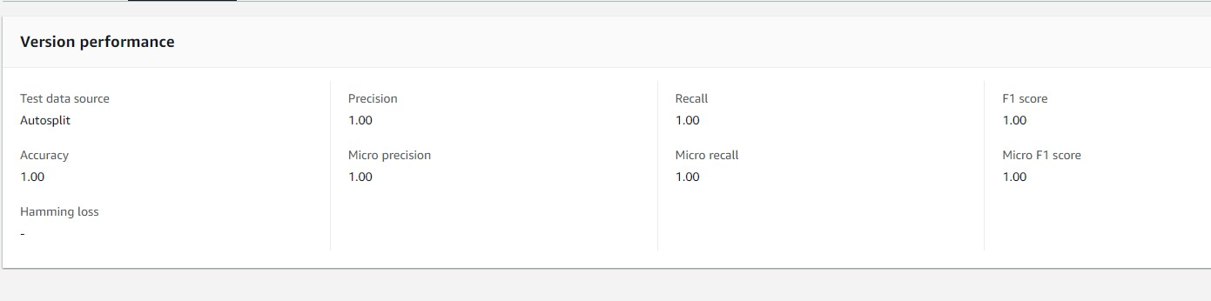
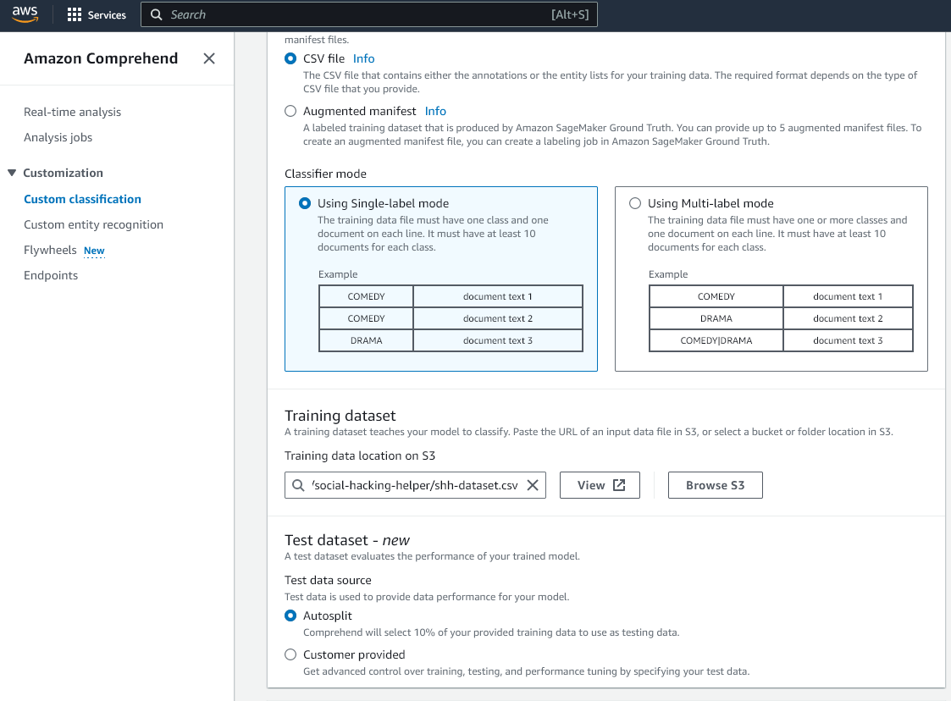
Presentation Outline
GenAI Prompt
Dataset Examples
Amazon Comprehend
Customer ML Classifier
Amazon Connect
Real-life Demos
Evaluation
Limitations & Future Work

Slide 6


Thank You!

